Slide 1

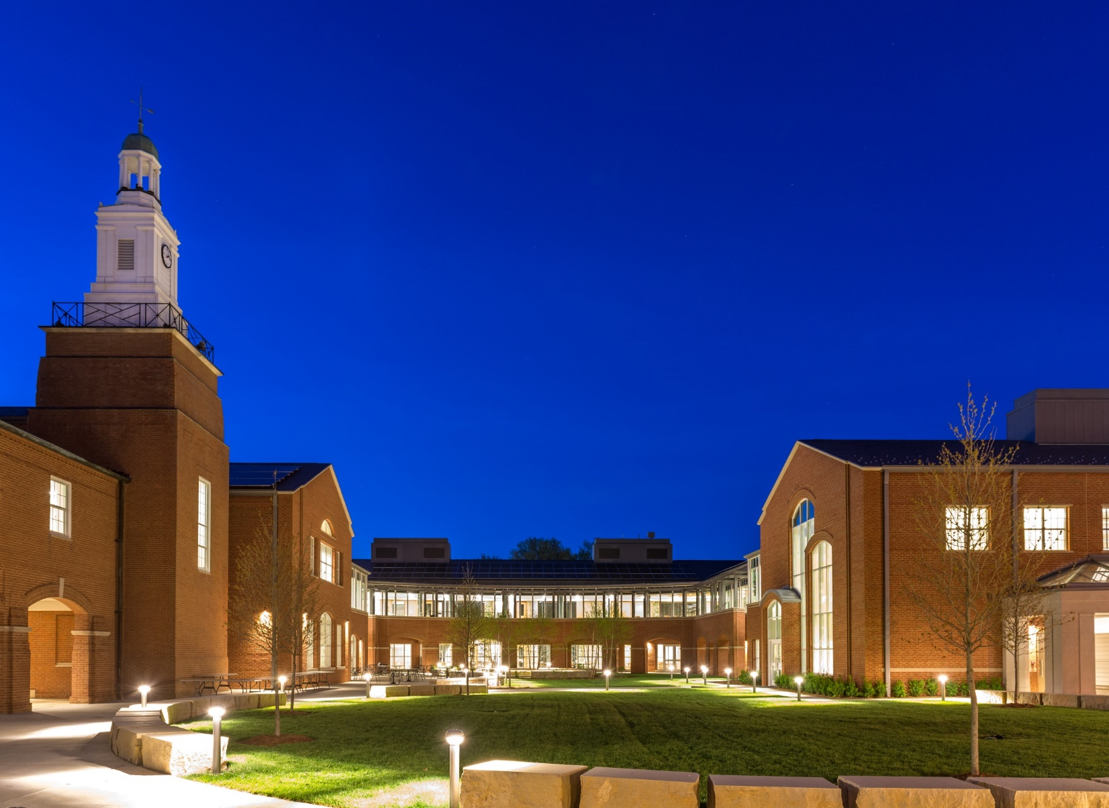

McDonnell Hall and Brauer Hall
Rainwater Harvesting

Slide 2
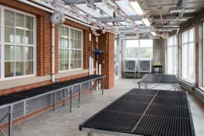
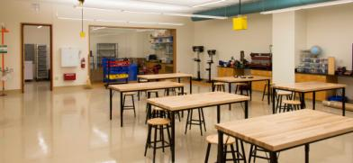
STEM Building
Features:
800-seat auditorium
1,200 SF greenhouse
19 Classrooms
11 Labs
Robotics
Student Commons
Faculty offices

Slide 3
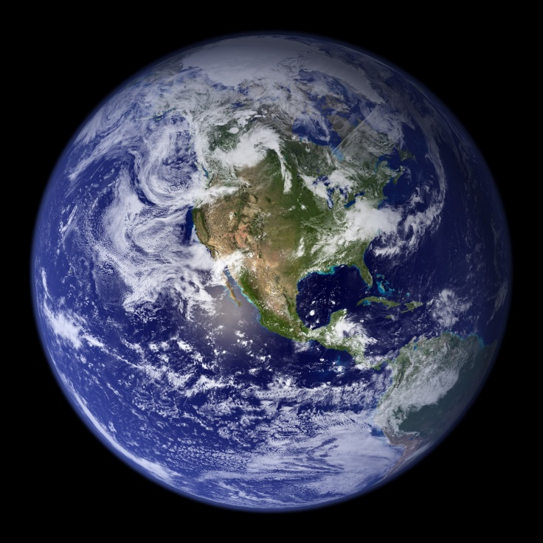
Bob Shaw
JK12 Science Department, Chair
Environmental Programs Director
A BIG DEAL

Slide 4
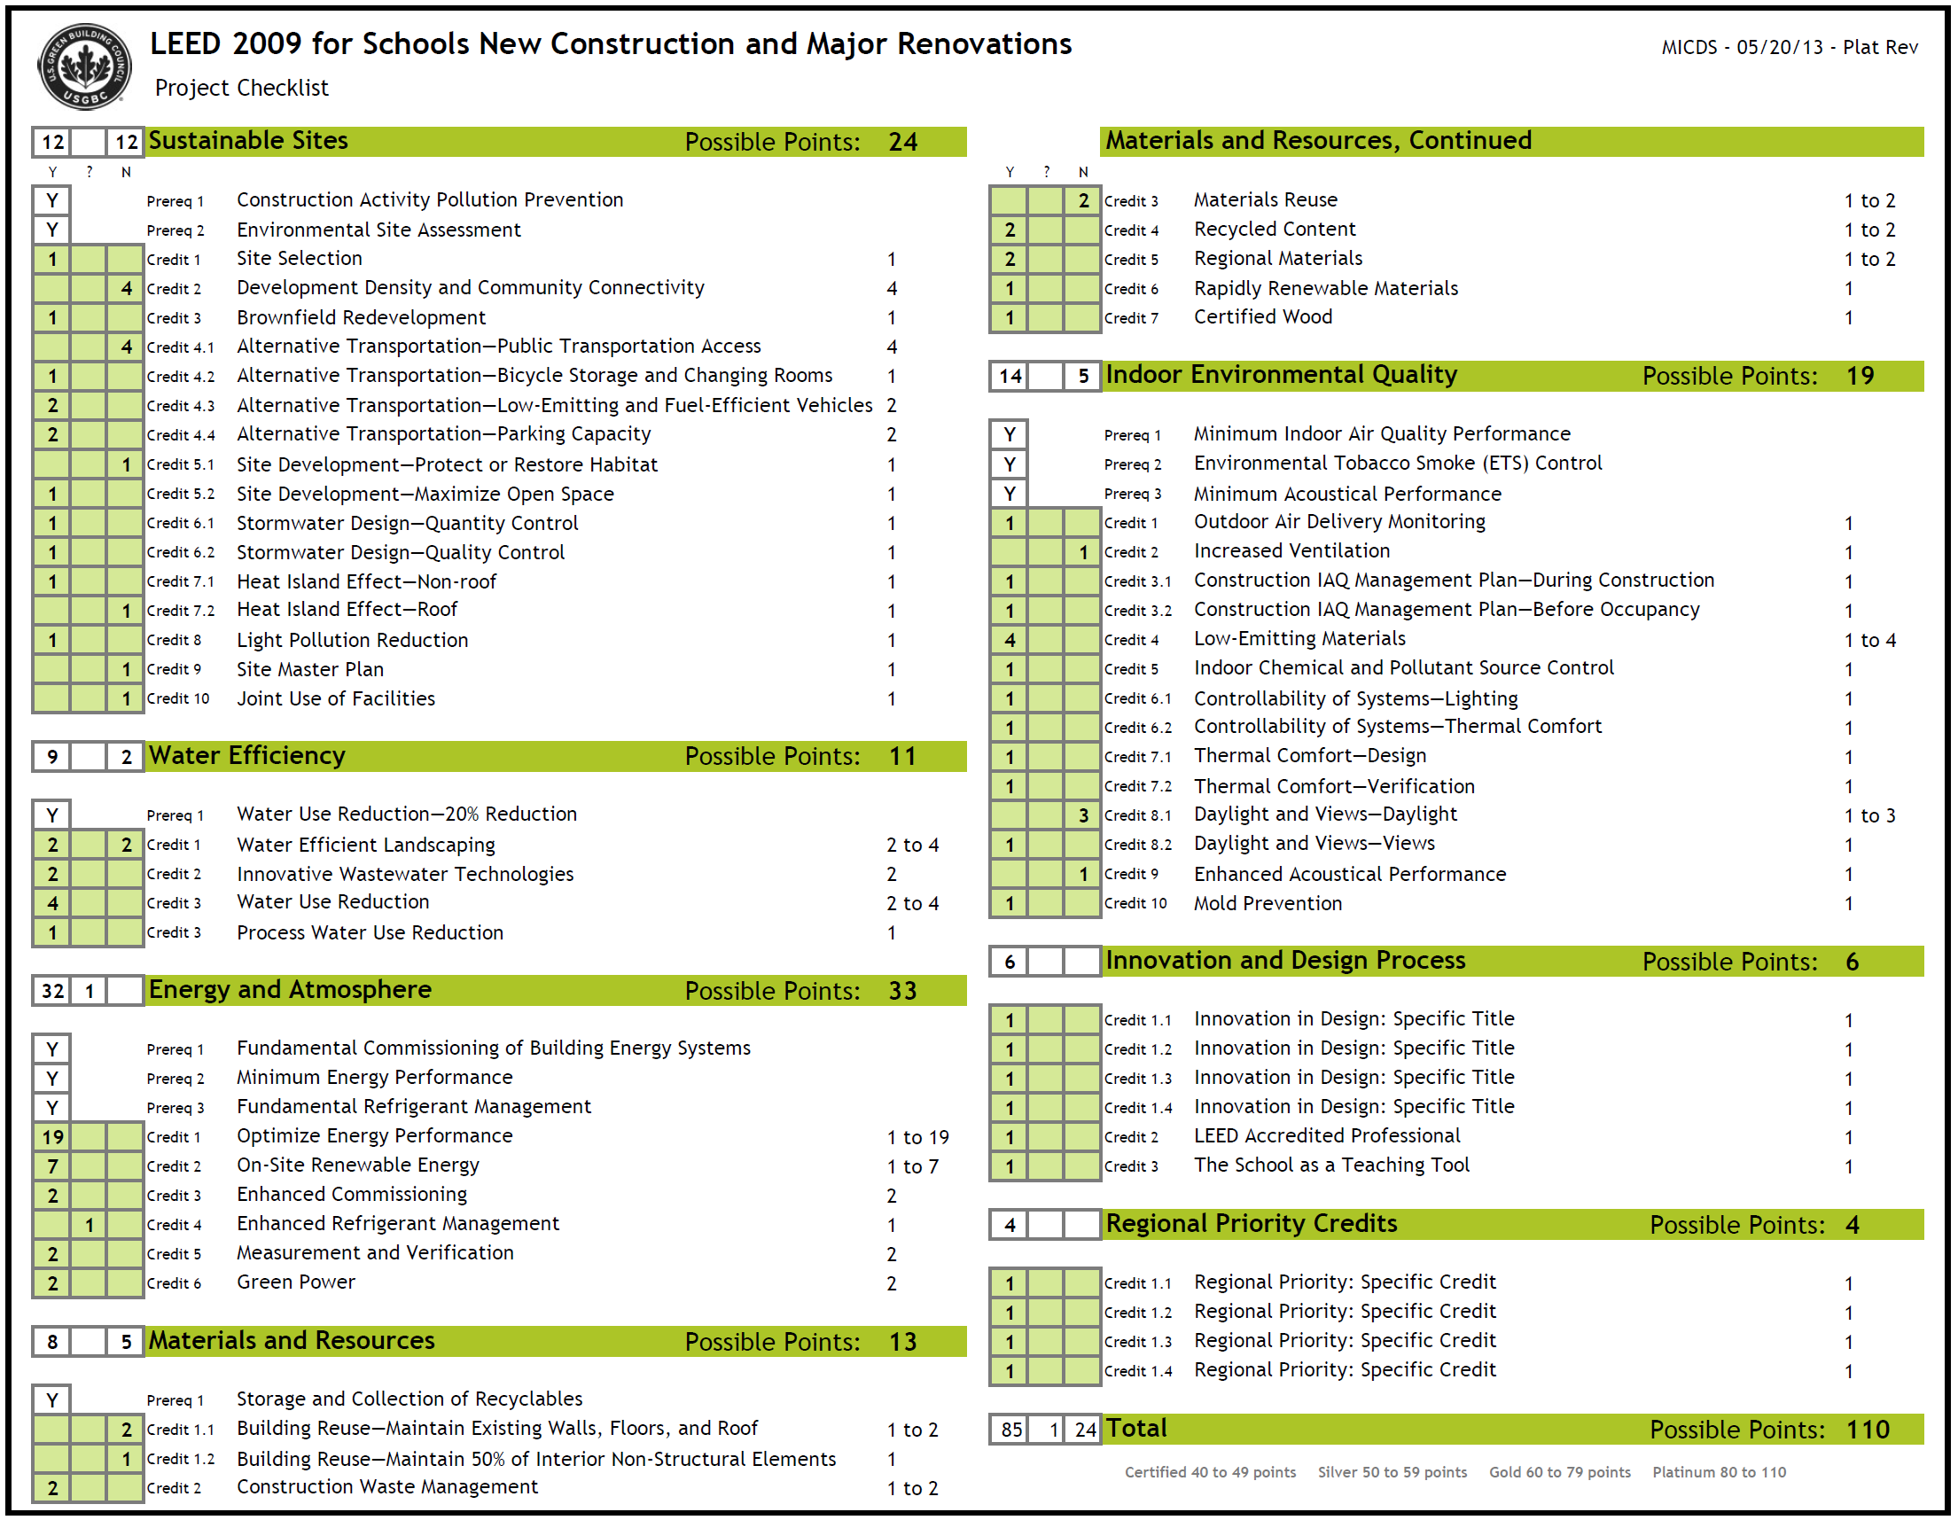

Slide 5

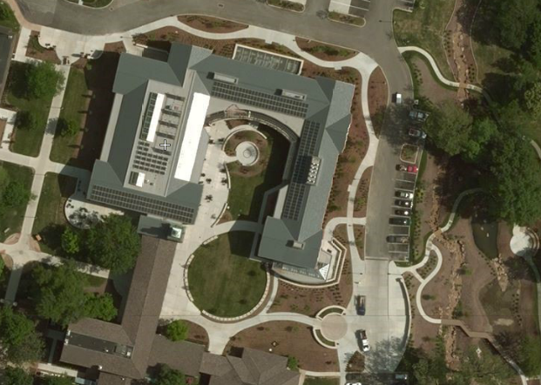
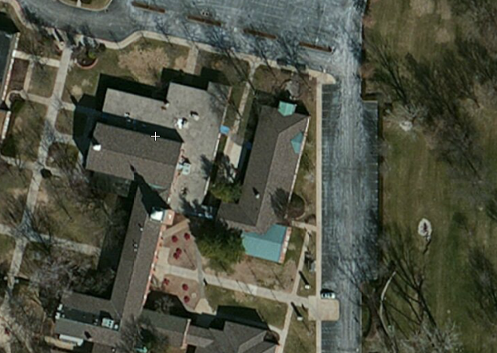
Big Picture
Why a Sustainable Building?
Initial Costs?
Costs over time?
Savings?

Slide 6
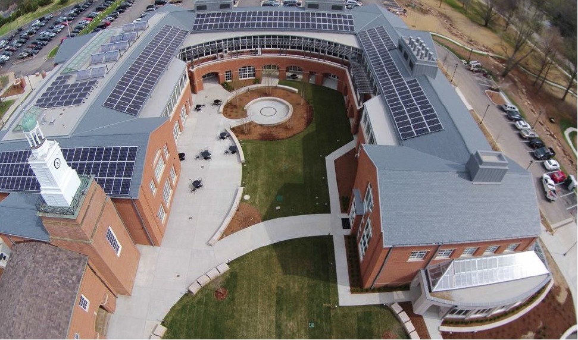

Slide 7
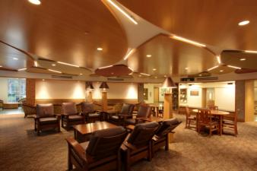
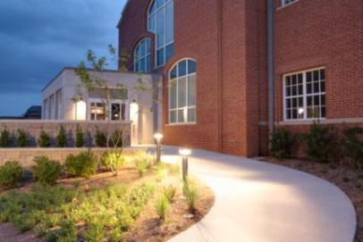
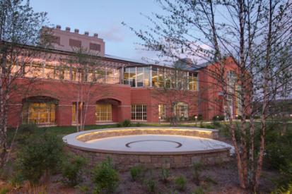
STEM Facts
86,000 GSF building, replaces 3 existing buildings
Modernizes the teaching facilities for math and science; classrooms and labs joined together for application based learning.
Brings new significant opportunities to staff and students

Slide 8
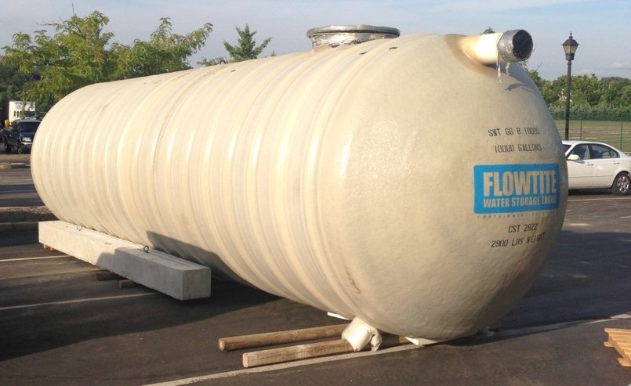
Jim Barciszewski
Director of Maintenance

Slide 9
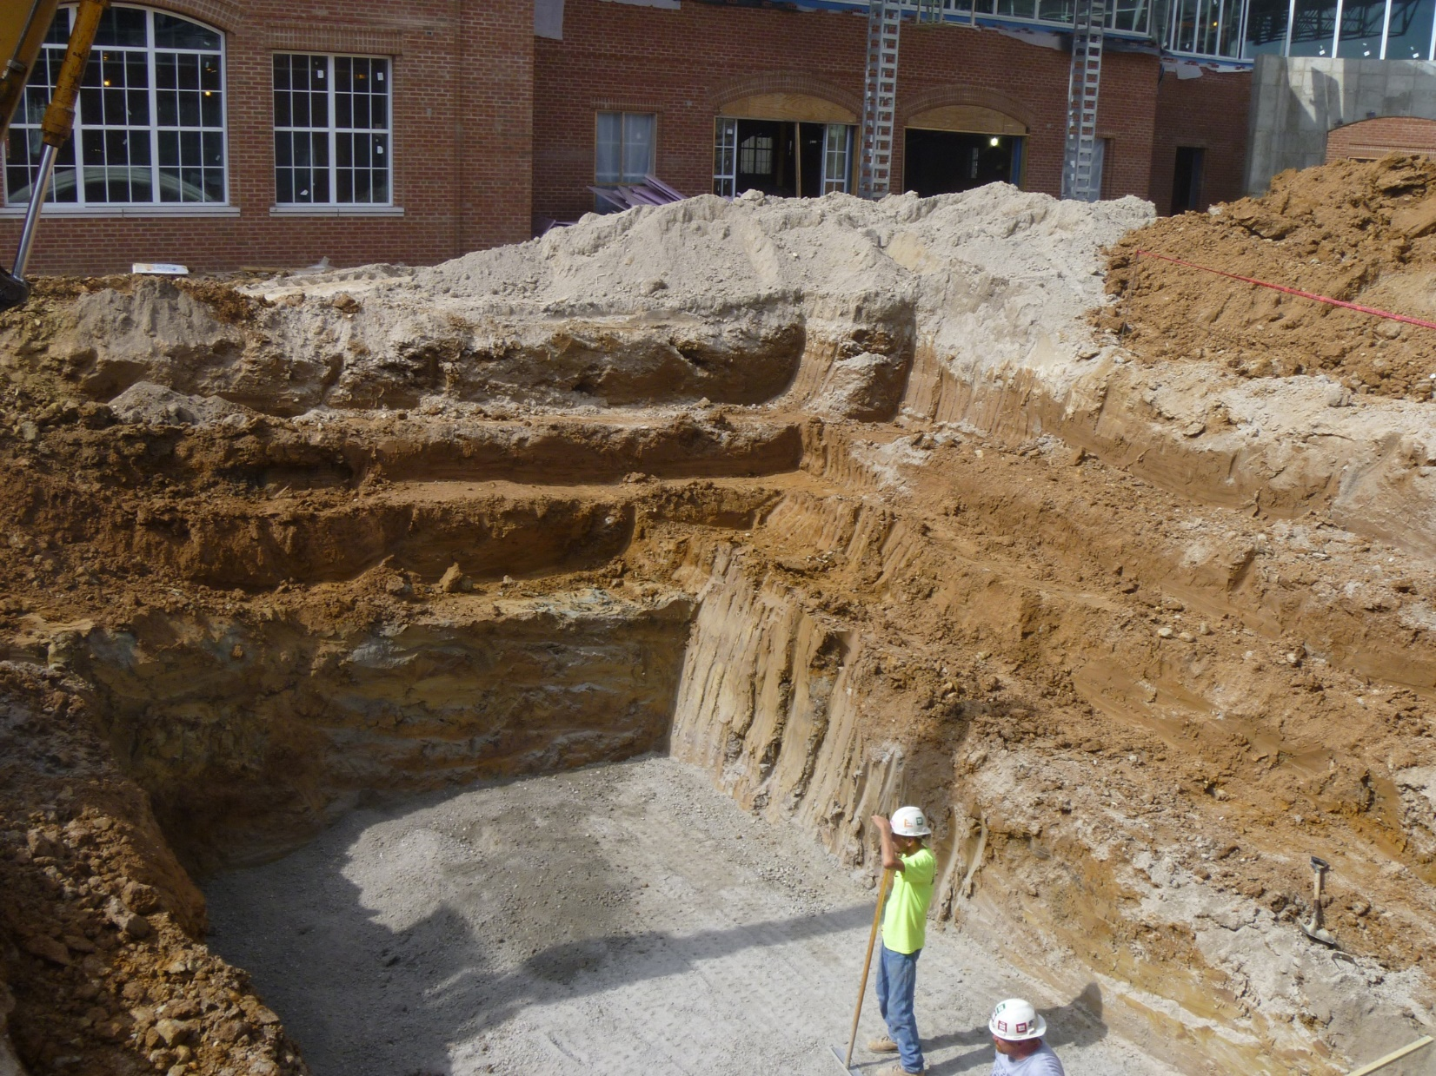

Slide 11
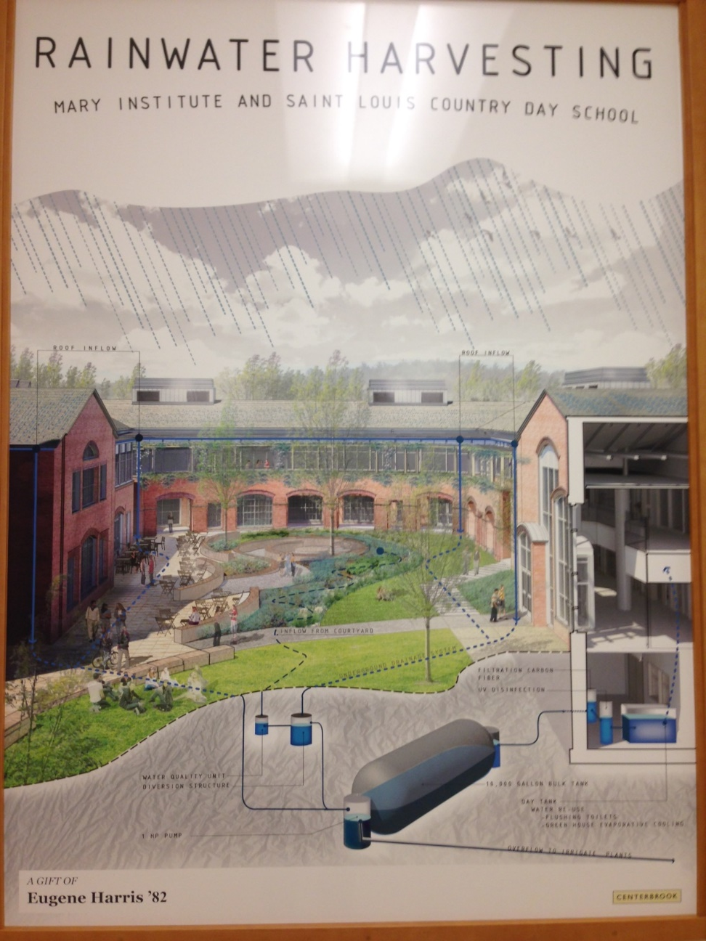
System Overview
Water collection process
Day Tank
Water treatment
Water distribution
Restrooms
GH Evaporative Cooling
Low Water Levels
High Water Levels
Power failure

Slide 12
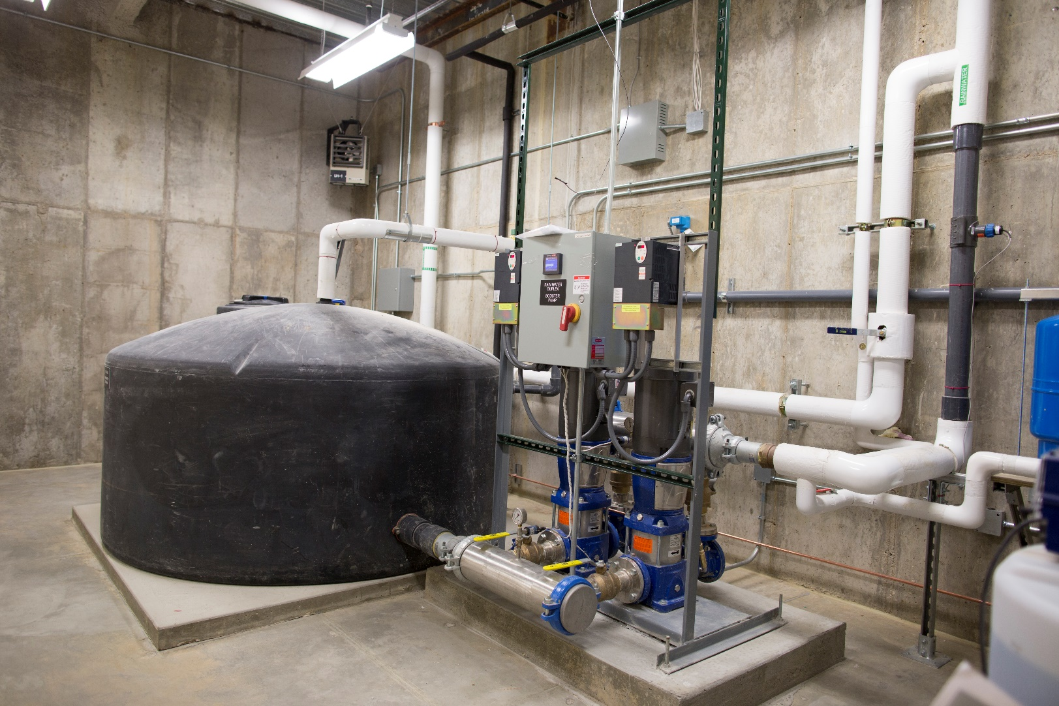
Day Tank Room

Slide 13
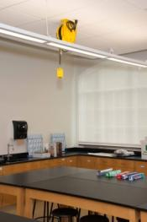
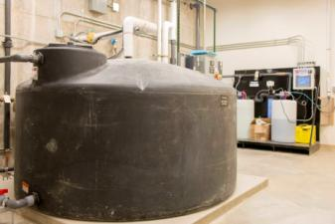
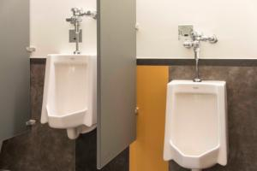
Water Efficiency
Innovative Wastewater Technologies
Water Use Reduction
Operation/Maintenance
Other things we have learned…

Slide 14
Bob Shaw
JK12 Science Department, Chair
Environmental Programs Director
A BIG DEAL

Slide 15
STEM Curriculum
Features:
Advance Placement Environmental Science Home Design
Several Math and Science Classes use the dashboard data for real world data crunching
Several Science Classes compare the weather to PV production vs. Water collection
City Action Project: STEM Building used as living example of LEED Design
UV light and Solar Pasteurization

Slide 16
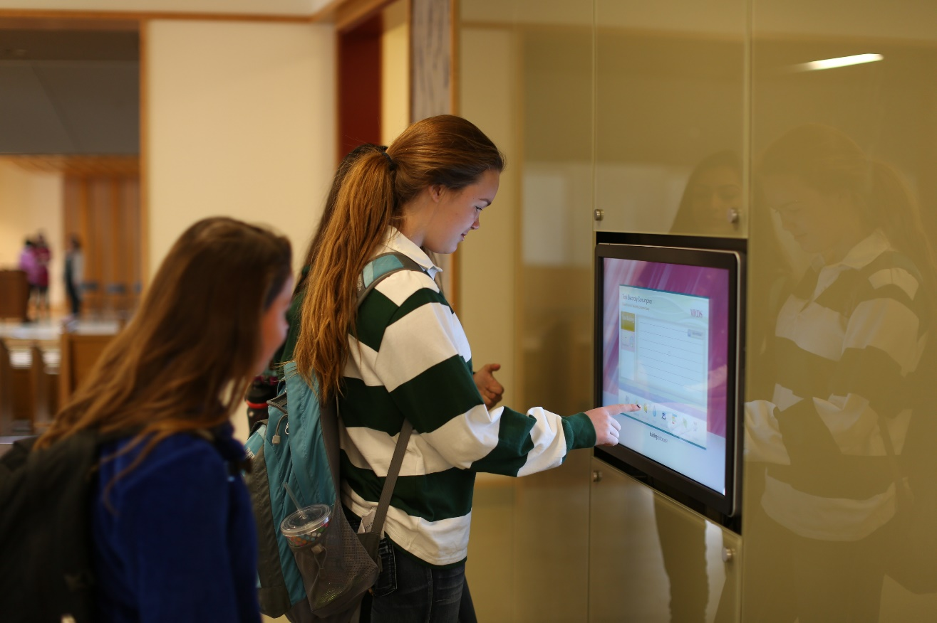
STEM Curriculum

Slide 17
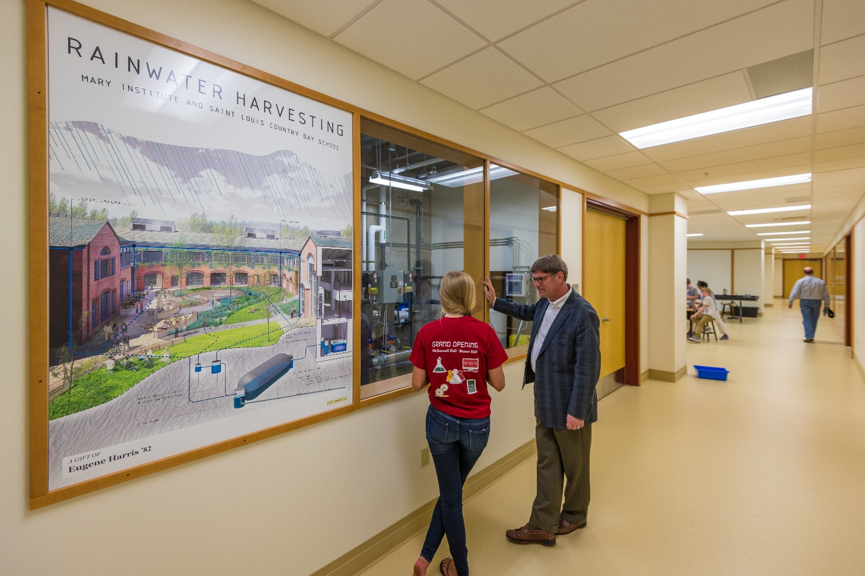

Slide 18
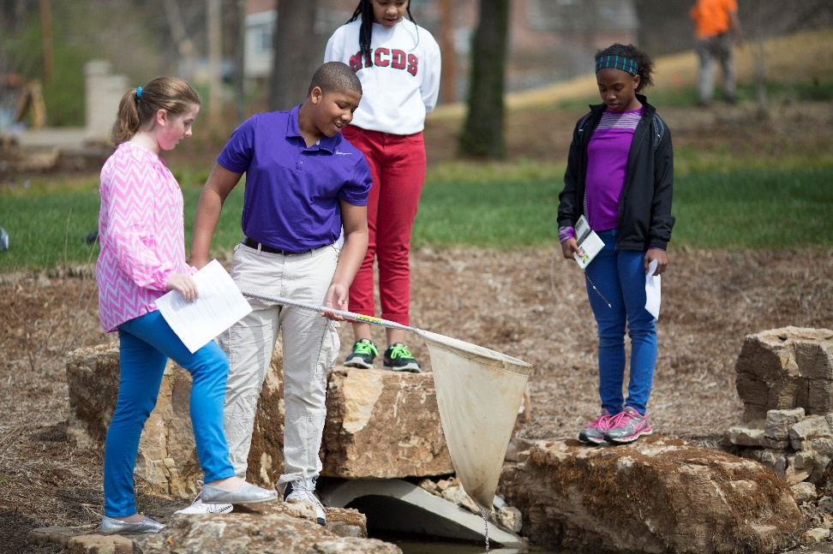
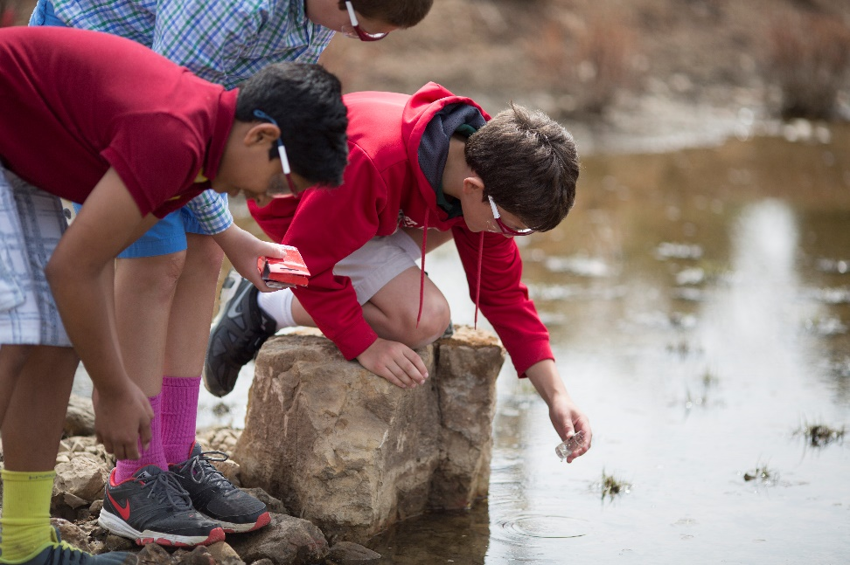
Water Quality Testing

Slide 19
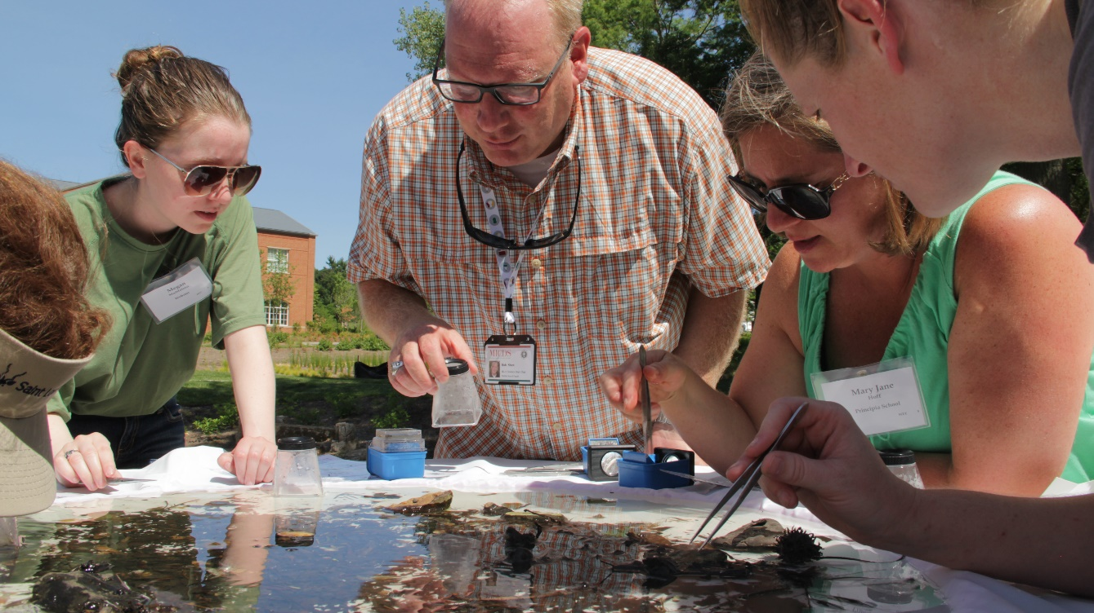
STEM Facility
Hosting several community meetings and Sustainability Institutes
Hosted 40+ Schools interested in our building design.
And counting…

Slide 20

Field Trip
Vortex
Day Tank Room
Greenhouse Evaporative Cooler
Reflection Pool/Water Feature
Bioswale

Slide 21
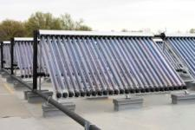
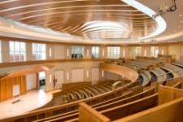
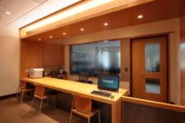
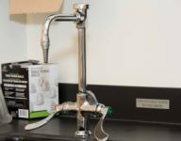

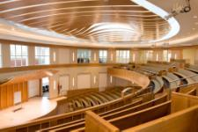
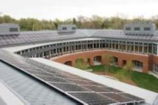
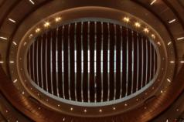

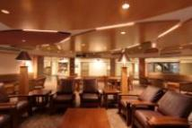
Thank You
Please contact us for more information
rshaw@micds.org

